Slide 1
Tools for Maintaining Coding Standard in PHP

Slide 2
PHP intelliSense: This is just the VS Code extension that show the actual language of the server. It helps developer by autosuggesting the PHP code.

Slide 3
Format Html in PHP: This extension provides formatting for the HTML code in PHP files.

Slide 4
Path Intellisence: Visual Studio Code plugin that autocompletes filenames.

Slide 5
Bookmarks: It helps you to navigate in your code, moving between important positions easily and quickly.

Slide 6
Auto Rename Tag: Automatically rename paired HTML/XML tag, same as Visual Studio IDE does.

Slide 7
Auto Close Tag: Automatically add HTML/XML close tag, same as Visual Studio IDE or Sublime Text does.

Slide 8
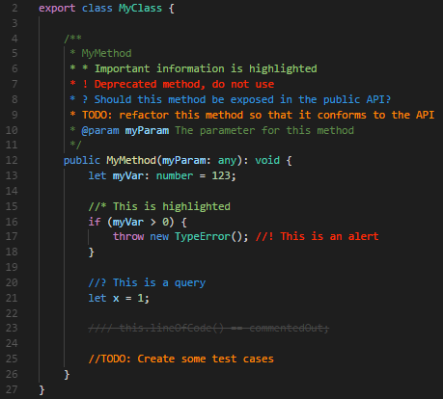
Beautify: Beautify Javascript, JSON, CSS, SASS and HTML in Visual Studio Code.
Better Comments: The Better Comments extension will help you create more human-friendly comments in your code.

Slide 9
PHP Intelephense:
High performance and rich in PHP feature extension.
Helpful in formatting PHP.
HTML request forwarding allowing for a full HTML/Javascript/CSS/PHP development experience.
Fast camel/underscore case workspace symbol search.

